Slide 1
Predicting Patient Readmissions
Analysts: Wei-Chun Lin, Megan Grout, Colleen Xu
Notes:
MEGAN

Slide 2
Background
Notes:
MEGAN

Slide 3

Today’s Goal
Better understand impact of readmissions on our company and how we can reduce them to improve patient health, decrease cost, and increase customer satisfaction.
Notes:
MEGAN

Slide 4
Today’s Plan
Present the case for change
The solution: LACE
Explain the preliminary model
Looking forward
Notes:
MEGAN

Slide 5
Why do we need to change?
Notes:
COLLEEN

Slide 6

Currently...
$11,000
Average Cost per Readmission
30-Day Readmissions: a one-two punch
1% average Medicare penalty over the last 3 years
Physicians use professional judgment to classify readmission risk
“Low”, “Medium”, “High”
Intervene in “High” risk cases
Without intervention in high-risk cases, patients are readmitted in poorer health and report low satisfaction
Notes:
COLLEEN
30-day readmission cases: two unplanned hospital visits less than 30 days apart (less than one month between discharge date of first to admit date of the next).
Major cost to treat these patients. Additionally, we get penalized by Medicare for readmission cases for various conditions (joint replacements, congestive heart failure, heart attacks).
Basis for intervention: w/o it, patients are readmitted in poorer health and report low satisfaction.

Slide 7
Impact of no change
Notes:
COLLEEN

Slide 8
Future costs of status quo
Expecting penalty increase
Every year, more health conditions are added to the Medicare penalty
~ 10,000 readmissions / year (over our 54 hospitals)
We need to do a better job at targeting patients with a high-risk of readmission
Use low-cost interventions at/after discharge to prevent readmission
Notes:
COLLEEN
Low-cost interventions “described in the literature” include…
Having a pharmacist check for medication interactions (current medications vs discharge medications list),
Having a social worker / case manager meet with the patient before discharge to discuss social support resources,
Sending alert to primary care physician’s office to schedule follow-up
This was the goal of our pilot project! Toward that end, we took ~34,000 hospital visits from our enterprise data warehouse as our dataset to build a model to predict which patients had 30-day readmissions...

Slide 9
The solution!
Notes:
MEGAN STARTS HERE

Slide 10

LACE
L = Length of stay
A = Acuity of admission
C = Cormorbidities
E = Emergency department visits
Notes:
MEGAN
A group in Canada developed an algorithm called LACE to classify the severity of patient cases. This can be used to know when to intervene in attempts to prevent avoidable readmissions or deaths within 30 days of discharge.

Slide 11
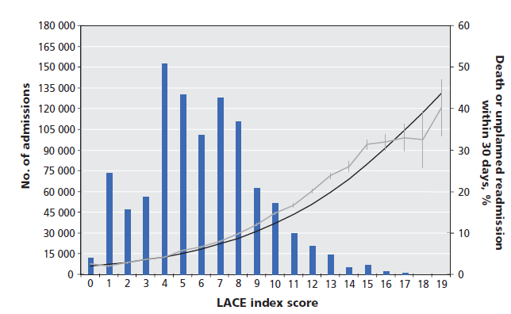
LACE
van Walraven, et al.
Notes:
MEGAN
Plot of independently-validated LACE algorithm

Slide 12
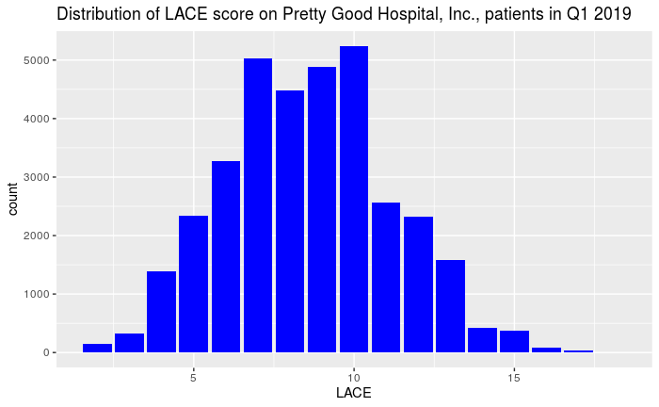
LACE
Notes:
MEGAN
Plots look similar → our population looks like it would be a good candidate for LACE

Slide 13
Diving deeper...
Notes:
WEI-CHUN

Slide 14
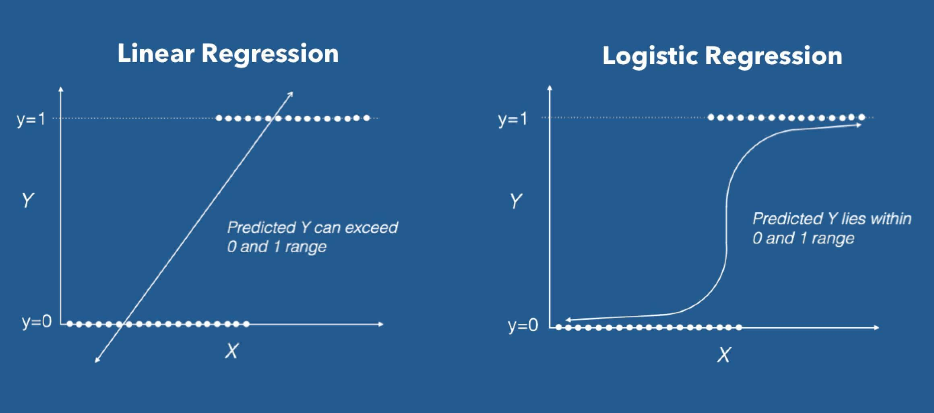
Simple Logistic regression
Logistic Regression is used for the classification problems, it is a predictive analysis algorithm and based on the concept of probability.
https://towardsdatascience.com/introduction-to-logistic-regression-66248243c148
Notes:
WEI-CHUN STARTS HERE
Spit dataset into training and testing (80/20)
Our preliminary model is logistic model
Examples of logistic regression - determine the tumor is malignant or not...

Slide 15
Model performance on test data
N = 6901 | Actual: Readmission | Actual: No readmission
Predicted: High-Risk for Readmission | 608 | 2,274
Predicted: No readmission | 421 | 3,598
Notes:
WEI-CHUN
We already know average cost of readmission is 11,000$....
Specificity = 61%
Sensitivity = 59% (CX: proportion of readmitted patients correctly identified by the model)
Accuracy = 61% indicates the overall ability of the model to correctly predict what the patient will readmit or not
CX note: mention that you built the model using most of the data (training data) and tested its predictive performance on test data.

Slide 16
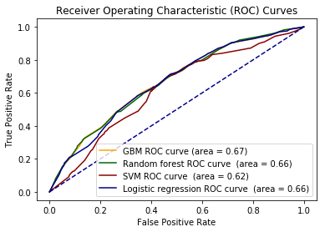
Choosing a model
Notes:
WEI-CHUN
The area under the ROC curve (AUC) measures discrimination, which means the ability of the prediction model will be able to distinguish between readmit or not
Logistic model has 66% chance to distinguish between positive class and negative class.
CX Note: Talk about the different models tried FIRST, say we then picked logistic regression for interpretability and best predictive ability

Slide 17
Potential cost savings (test data)
Sum | Number of patients | Cost/Savings per patient | Description
$6.7 million | 608 | $11,100 | Actual Readmissions Identified by the model (~1% Medicare penalty + hospital costs)
$2.9 million | 2882 | $1000 | Patients Flagged by model for Interventions
$3.8 million SAVINGS (6902 patients)
Notes:
Colleen Xu
Test data represents only a fraction of the patients we see in a year.

Slide 18
Looking Forward...
Notes:
COLLEEN

Slide 19

Adding readmission risk prediction to workflow
Readmission risk flag in EHR
Categorize hospital patients automatically using model and EHR data
Triggers alerts for interventions
pre-discharge processes (social work, pharmacy)
Post-discharge processes (PCP follow-up, phone call)
Successful implementation depends on listening to end-users and incorporating their feedback
Notes:
COLLEEN
Feedback includes what to include in the model, the relative importances of variables, ways to incorporate into workflow

Slide 20

Measuring impacts
Effects on workflow:
% of alerts acted upon
Feedback from end-users
Measures of success:
# of 30-day readmissions
Average cost / patient
Patient satisfaction (post-visit survey)
ROI seen within a few months, if interventions effective
Medicare penalty will gradually drop
Notes:
COLLEEN
Average cost per patient would be over several months...

Slide 21
Team Players
Notes:
MEGAN

Slide 22

Roles
Proposed Sponsorship
Dr. Kathy Whatver, CTO
Dr. Louis Shin, VP of Patient Care
Morgan Wyatt, PharmD, Senior Hospital Analyst
Analyst Roles
Develop work plan with Intervention work group
Write code to calculate LACE in EMR
Implement feedback form and assess performance metrics
Notes:
MEGAN

Slide 23

Call to action - 1.5 year project roadmap
Support from sponsors for expanded project
Bring end-user reps, stakeholders together
Form Intervention workgroup
Phase 1: Improving the model by working with end-users to tweak/add variables
~ 9 months
Phase 2: model prediction and interventions implemented at 12 locations
~ 3 month set-up, 6 month trial implementation
Notes:
COLLEEN
Choose hospitals for pilot program

Slide 24
Questions?

Slide 25
Sources
van Walraven, et al. Derivation and validation of an index to predict early death or unplanned readmission after discharge from hospital to the community. CMAJ. 6 Apr 2010. 182(6). 551 - 557.

